Slide 1
SARS CoV 1 & 2 Infections
Presenter: Dr. Leina Hipoliti
Facilitator: Dr. Moledina

Slide 2
Outline
Virology and Immunology
Immune Responses
Epidemiology
Clinical Features
Complications
Recovery and Long-Term Sequelae
Diagnosis
Management as Out-Patient and In-Patient
Discussion Qn

Slide 3
Virology and Immunology
Coronaviruses are enveloped, positive-sense, ssRNA viruses.
Belong to genus Betacoronavirus.
Cause respiratory disease (mild – severe)
  SARS-CoV-1: caused 2002 – 2004 SARS outbreak
  SARS-CoV-2: causes COVID-19 pandemic

Slide 4
Virology and Immunology
Both use ACE2 receptor for cell entry (high in lungs, gut, heart, kidneys).
TMPRSS2 – used by delta variant while omicron variant uses cathepsin-dependent endocytosis.
They bind through receptor binding domain of their spike protein.
SARS-CoV-2 antivirals target one of two important viral proteins: RdRp (remdesivir, molnupiravir) and 3CL protease (ritonavir-boosted nirmatrelvir)

Slide 5
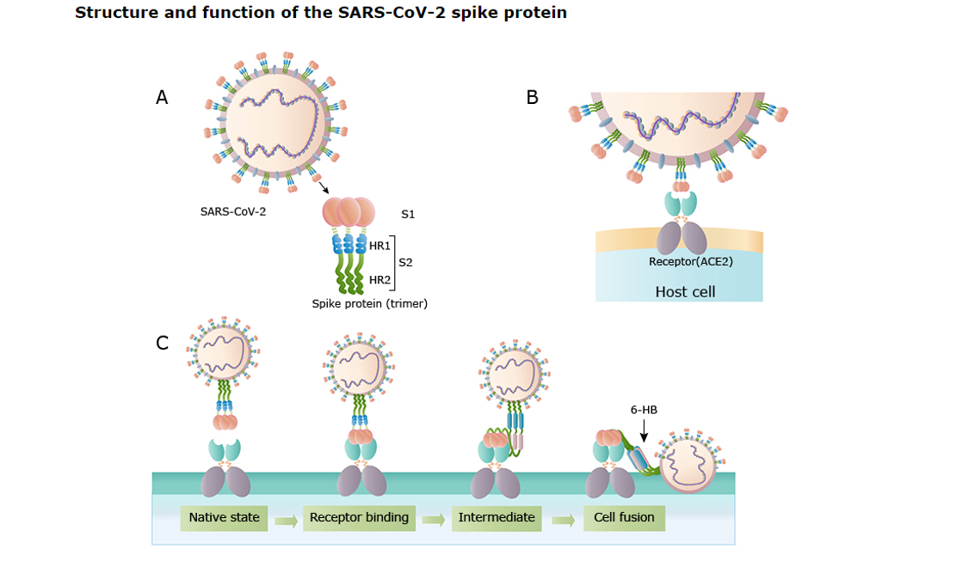
Uptodate.com

Slide 6
Immune Responses
Humoral Immunity
Patients develop protective antibodies to the receptor binding protein domain of the viral spike protein and associated neutralizing activity.
Some studies report detectable neutralizing activity up to 12 months.
Antibodies and neutralizing activity confer protection from subsequent infection but not from a different variant.
Crawford KHD, Dingens AS, Eguia R, Wolf CR, Wilcox N, Logue JK, Shuey K, Casto AM, Fiala B, Wrenn S, Pettie D, King NP, Greninger AL, Chu HY, Bloom JD. Dynamics of Neutralizing Antibody Titers in the Months After Severe Acute Respiratory Syndrome Coronavirus 2 Infection. J Infect Dis. 2021 Feb 3;223(2):197-205. doi: 10.1093/infdis/jiaa618. PMID: 33535236; PMCID: PMC7543487.

Slide 7
Cont…
Cell-mediated Immunity
Studies have identified SARS-CoV-2 specific CD4 and CD8 T-cell responses in patients who had recovered from COVID-19.
These cells were also noted in individuals who received COVID-19 vaccination.
Dan JM, Mateus J, Kato Y, Hastie KM, Yu ED, Faliti CE, Grifoni A, Ramirez SI, Haupt S, Frazier A, Nakao C, Rayaprolu V, Rawlings SA, Peters B, Krammer F, Simon V, Saphire EO, Smith DM, Weiskopf D, Sette A, Crotty S. Immunological memory to SARS-CoV-2 assessed for up to 8 months after infection. Science. 2021 Feb 5;371(6529):eabf4063. doi: 10.1126/science.abf4063. Epub 2021 Jan 6. PMID: 33408181; PMCID: PMC7919858.

Slide 8
Epidemiology
Since the first reports of SARS-CoV-2, infection has spread to every corner of the globe.
Cases occur year-round, peaks and hospitalizations occur particularly in the winter and to a lesser degree in the summer.
Risk for severe disease include – older age, certain medical comorbidities e.g., immunocompromise, pregnancy and lack of vaccination.

Slide 9
Cont…
Risk of reinfection – Common especially more than 180 days after previous infection (with a different SARS-CoV-2 sublineage than the one responsible for initial infection).
Transmission – Person to person by respiratory/airborne transmission as primary route.
Proximity to index case and time for exposure are the main determinants of transmission.
Hu M, Lin H, Wang J, Xu C, Tatem AJ, Meng B, Zhang X, Liu Y, Wang P, Wu G, Xie H, Lai S. Risk of Coronavirus Disease 2019 Transmission in Train Passengers: an Epidemiological and Modeling Study. Clin Infect Dis. 2021 Feb 16;72(4):604-610. doi: 10.1093/cid/ciaa1057. PMID: 32726405; PMCID: PMC7454391.

Slide 10
Cont…
Minimal role of other person-to-person routes – Include detection of SARS-CoV-2 in non-respiratory specimens like stool, blood, ocular secretions and semen.
No evidence that SARS-CoV-2 can be transmitted through contact with nonmucous membrane sites (e.g., abraded skin).
Discussion qn – Is there risk for vertical transmission?
Kirtsman M, Diambomba Y, Poutanen SM, Malinowski AK, Vlachodimitropoulou E, Parks WT, Erdman L, Morris SK, Shah PS. Probable congenital SARS-CoV-2 infection in a neonate born to a woman with active SARS-CoV-2 infection. CMAJ. 2020 Jun 15;192(24):E647-E650. doi: 10.1503/cmaj.200821. Epub 2020 May 14. PMID: 32409520; PMCID: PMC7828840.

Slide 11
Clinical Features
Spectrum of Disease:
Asymptomatic infections
Mild to moderate disease
Severe/critical illness
Risk Factors for severe disease include:
Not vaccinated
Increasing age
Immunosuppression and other comorbidities
Petrilli CM, Jones SA, Yang J, Rajagopalan H, O'Donnell L, Chernyak Y, Tobin KA, Cerfolio RJ, Francois F, Horwitz LI. Factors associated with hospital admission and critical illness among 5279 people with coronavirus disease 2019 in New York City: prospective cohort study. BMJ. 2020 May 22;369:m1966. doi: 10.1136/bmj.m1966. PMID: 32444366; PMCID: PMC7243801.

Slide 12
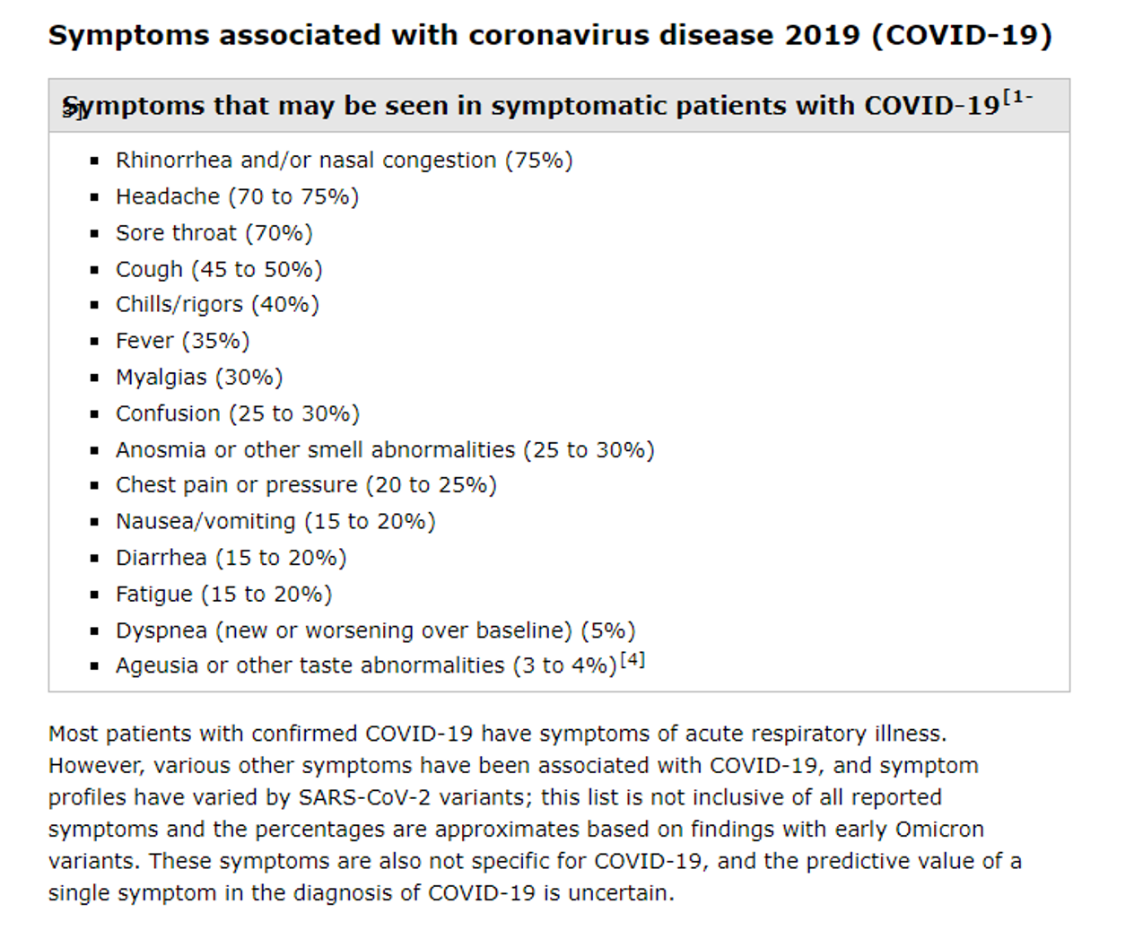
Initial Presentation
Uptodate.com

Slide 13
Cont…
Pneumonia is the most frequent serious manifestation.
Characterized primarily by fever, cough, dyspnea and bilateral infiltrates on chest imaging.
Dermatologic findings include:
  Maculopapular/morbilliform eruptions
  Transient livedo reticularis
  Reddish-purple nodules on distal digits (similar to pernio) or “COVID toes”

Slide 14
Complications
A study in Wuhan showed median time to dyspnea is 5 days since onset of symptoms and 8 days for hospital admission.
ARDS
  Major complication in pts with severe disease and manifest shortly after dyspnea.
  A mean of 12 – 24% of patients usually require mechanical ventilation.
Cardiac complications e.g., arrhythmias, myocardial injury, heart failure, shock.

Slide 15
Cont…
Thromboembolic complications
  - Venous thromboembolism include extensive DVT and P.E
  Arterial thrombotic events include acute stroke and limb ischemia.
Neurologic complications
  Encephalopathy common especially in critically ill patients.
  Stroke, movement disorders, ataxia and motor and sensory deficits occur less frequently.
Liotta EM, Batra A, Clark JR, Shlobin NA, Hoffman SC, Orban ZS, Koralnik IJ. Frequent neurologic manifestations and encephalopathy-associated morbidity in Covid-19 patients. Ann Clin Transl Neurol. 2020 Nov;7(11):2221-2230. doi: 10.1002/acn3.51210. Epub 2020 Oct 5. PMID: 33016619; PMCID: PMC7664279.

Slide 16
Cont…
Inflammatory complications
  Persistent fevers
  Elevated inflammatory markers (e.g., D-dimer, ferritin)
  Elevated proinflammatory cytokines
  GBS may occur (5 – 10 days after initial symptoms)
  Are associated with critical and fatal illnesses.
Secondary infections
  Bacterial coinfections (8%) and superinfections (20%) with K. pneumoniae, S. pneumoniae, S. aureus and Acinobacter spp (for the latter).
  Fungal and viral superinfections can also occur with EBV and invasive pulmonary aspergillosis.
Kurra N, Woodard PI, Gandrakota N, Gandhi H, Polisetty SR, Ang SP, Patel KP, Chitimalla V, Ali Baig MM, Samudrala G. Opportunistic Infections in COVID-19: A Systematic Review and Meta-Analysis. Cureus. 2022 Mar 31;14(3):e23687. doi: 10.7759/cureus.23687. PMID: 35505698; PMCID: PMC9055976.

Slide 17
Recovery & Long-Term Sequelae
Time of recovery is highly variable and depends on:
  Severity of illness (mild – within 2 weeks vs severe – 2 to 3 months)
  Age
  Pre-existing comorbidities
A subset of patients go on to develop post-COVID conditions also known as “long COVID.” (Fatigue, dyspnea, chest pain, cough and cognitive deficits).
Data suggest the potential for ongoing respiratory impairment and cardiac sequelae.

Slide 18
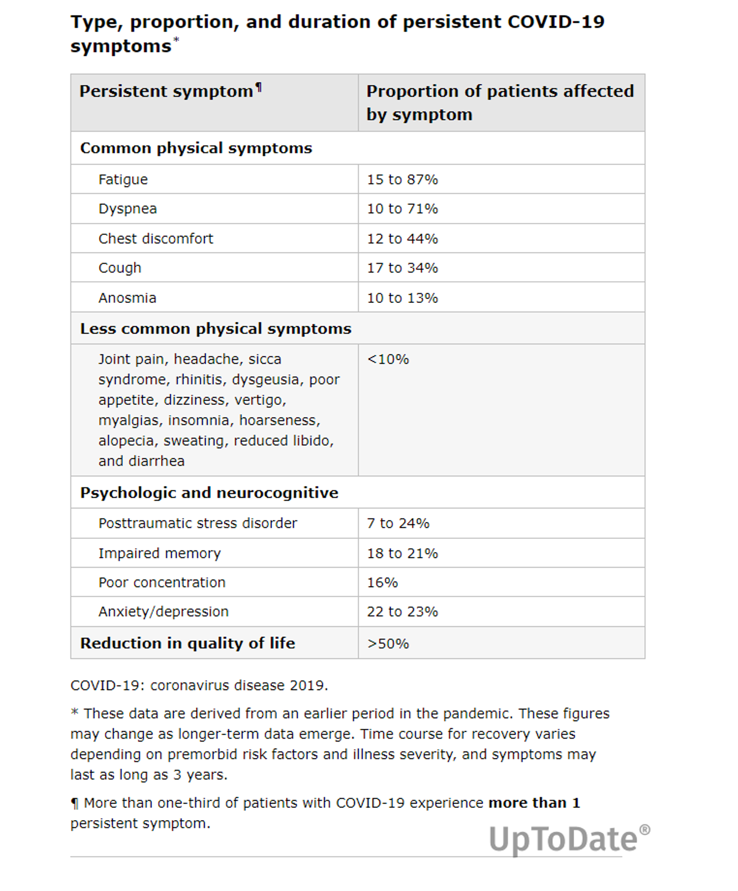

Slide 19
Diagnosis
Viral tests used include either an NAAT (RT-PCR) or an antigen test.
NAAT is preferred due to higher sensitivity. Can be rapid RT-PCR or standard laboratory – based NAAT.
Antigen tests are more accessible and convenient. Used more commonly for home testing and point of care sites.
Antigen tests can distinguish prolonged viral RNA shedding from a new infection.

Slide 20
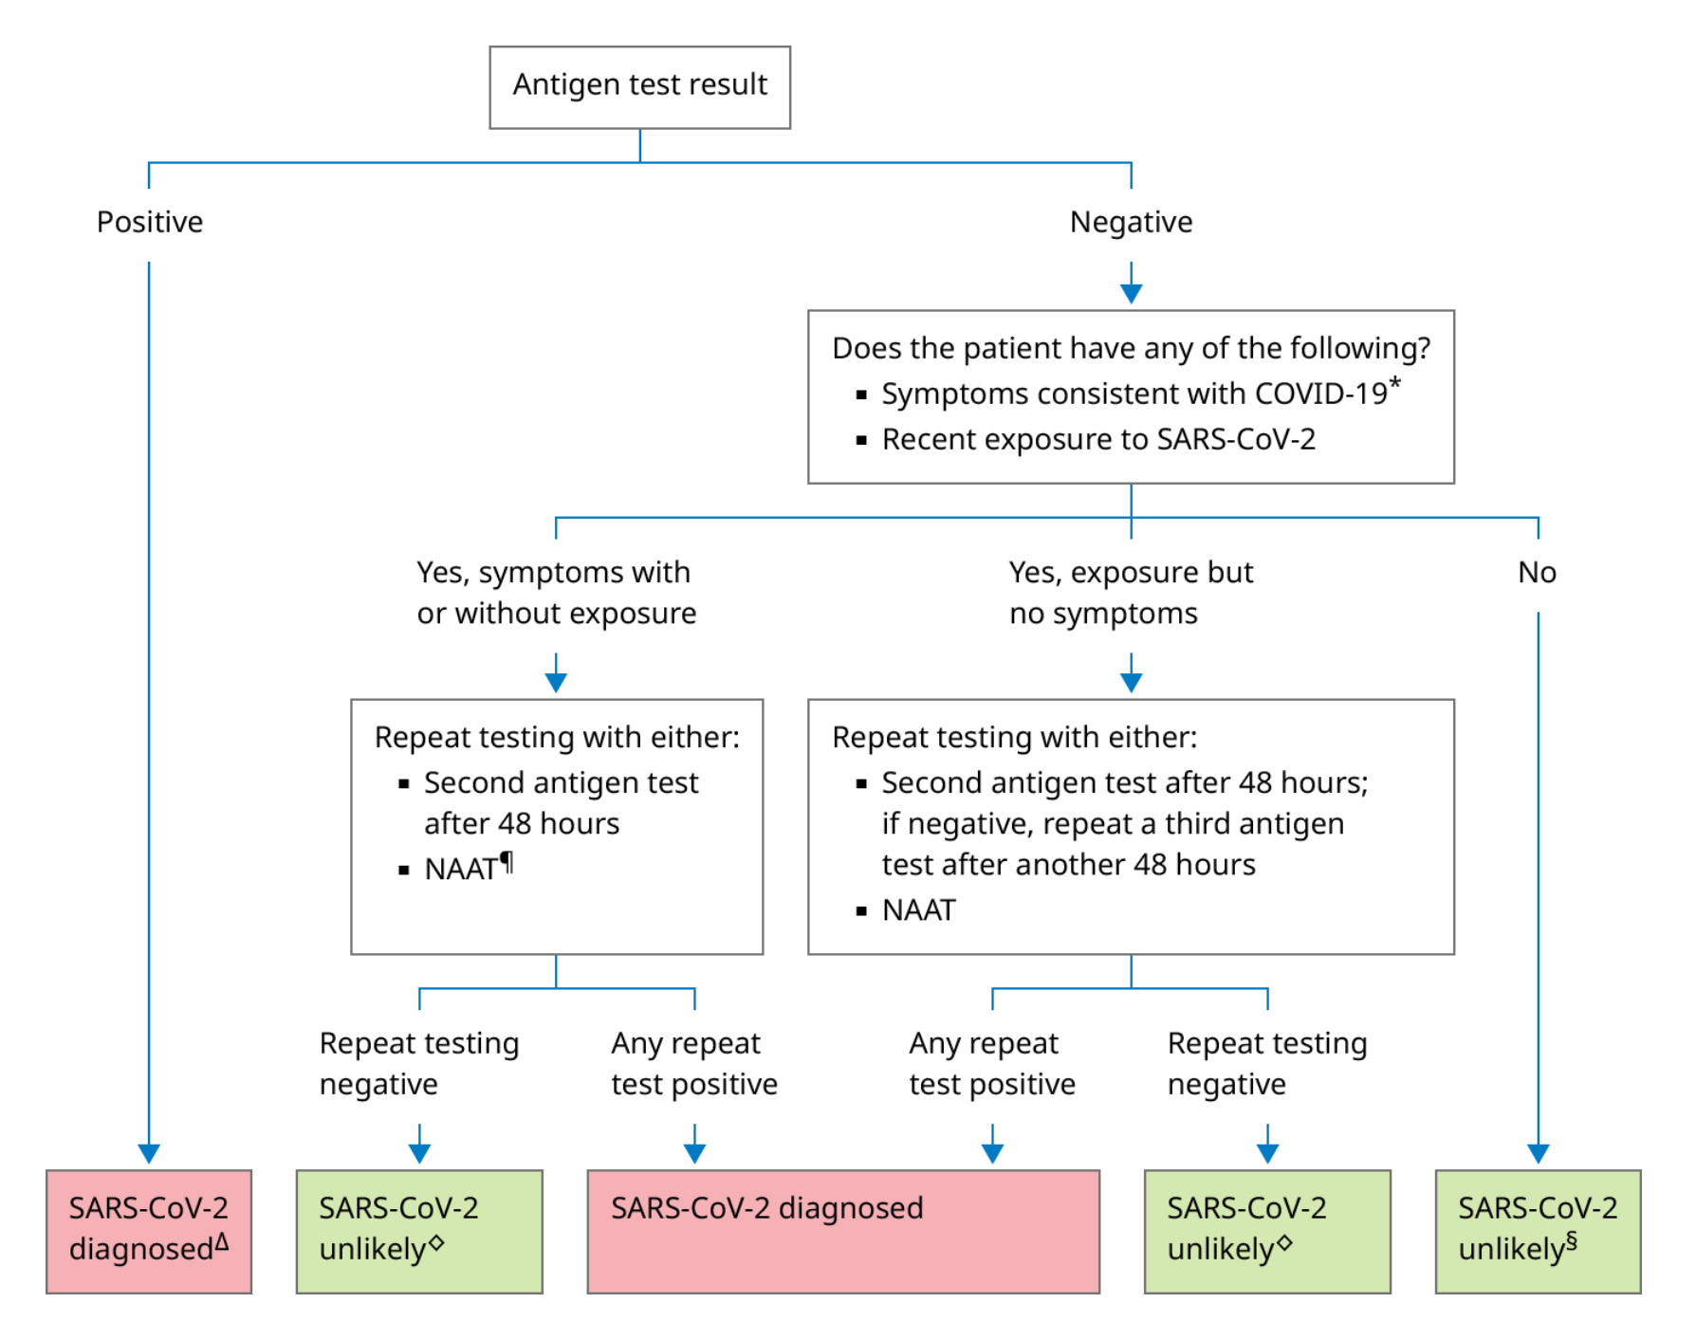

Slide 21
Specimens Collected
Upper respiratory samples are the primary specimens for both tests.
Specimens for NAAT include nasopharyngeal swab, nasal swab specimen from both anterior nares, nasal mid-turbinate swab.
Others include nasopharyngeal wash/aspirate, oropharyngeal swab or saliva.
Antigen test include all except oral or salivary specimens.

Slide 22
Laboratory Findings
Common lab findings among hospitalized patients with COVID-19 include:
  Lymphopenia (common)
  Elevated aminotransaminase
  Elevated LDH
  Elevated inflammatory markers (e.g., ferritin, CRP, ESR)
  Deranged coagulation profile (hypercoagulability)
  High D-dimer (associated with critical illness or mortality).
On admission, many patients with PNA have normal serum procalcitonin levels; however, in those requiring ICU care, they are more likely to be elevated.

Slide 23
Imaging Findings
Chest radiographs
  May be normal in early/mild disease
  Common findings include: consolidation and ground-glass opacities with bilateral, peripheral and lower lung zone distributions.
  Spontaneous pneumothorax may occur (uncommon, 0.56%)
Chest CT
  More sensitive than CXR
  Ground-glass opacifications – 83%
  Ground-glass opacifications with mixed consolidation – 58%
  Adjacent pleural thickening – 52%
  Interlobular septal thickening – 48%

Slide 24
Cont…
Air bronchograms can also be seen (46%)
Other less common findings were a crazy paving pattern (ground-glass opacifications with superimposed septal thickening), bronchiectasis, pleural effusion, pericardial effusion, and lymphadenopathy.
Findings are usually bilateral, have a peripheral distribution and involve lower lobes.

Slide 25
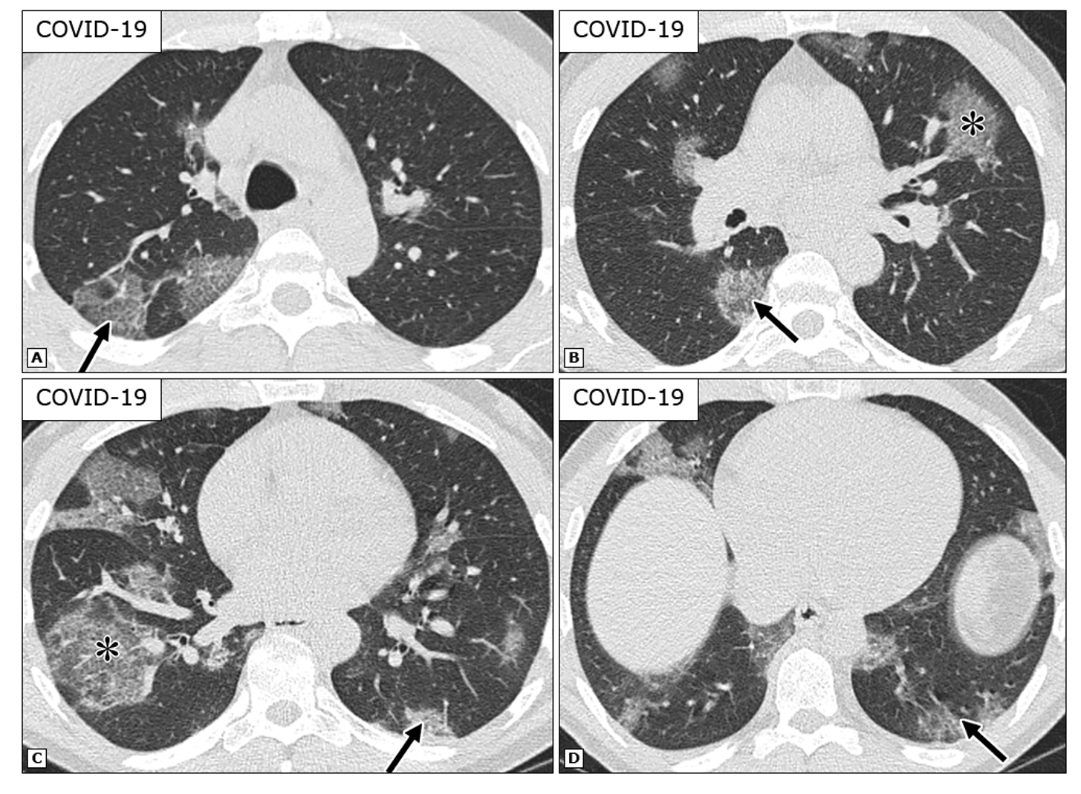
Uptodate.com

Slide 26
Cont…
Lung Ultrasound
  When other imaging resources are not readily available
  Findings include:
    Thickening, discontinuation, and interruption of the pleural line
    B lines visible under the pleura that appear discrete, multifocal, or confluent
    Patchy, strip, and nodular consolidations; and air bronchogram signs in the consolidations.
  -Less sensitive (86%) for the diagnosis of COVID-19.

Slide 27
Management in Out-Patient Setting
Primary objectives are to:
  Establish diagnosis
  Assess symptom severity and home setting to determine appropriate site of care
  Assess time course of infection
  Assess risk of progression to severe disease
Indications of hospitalization include:
  SpO2 <94% on R/A
  RR >30 breaths/min
  PaO2/FiO2 <300 mmHg
  Lung infiltrates >50%

Slide 28
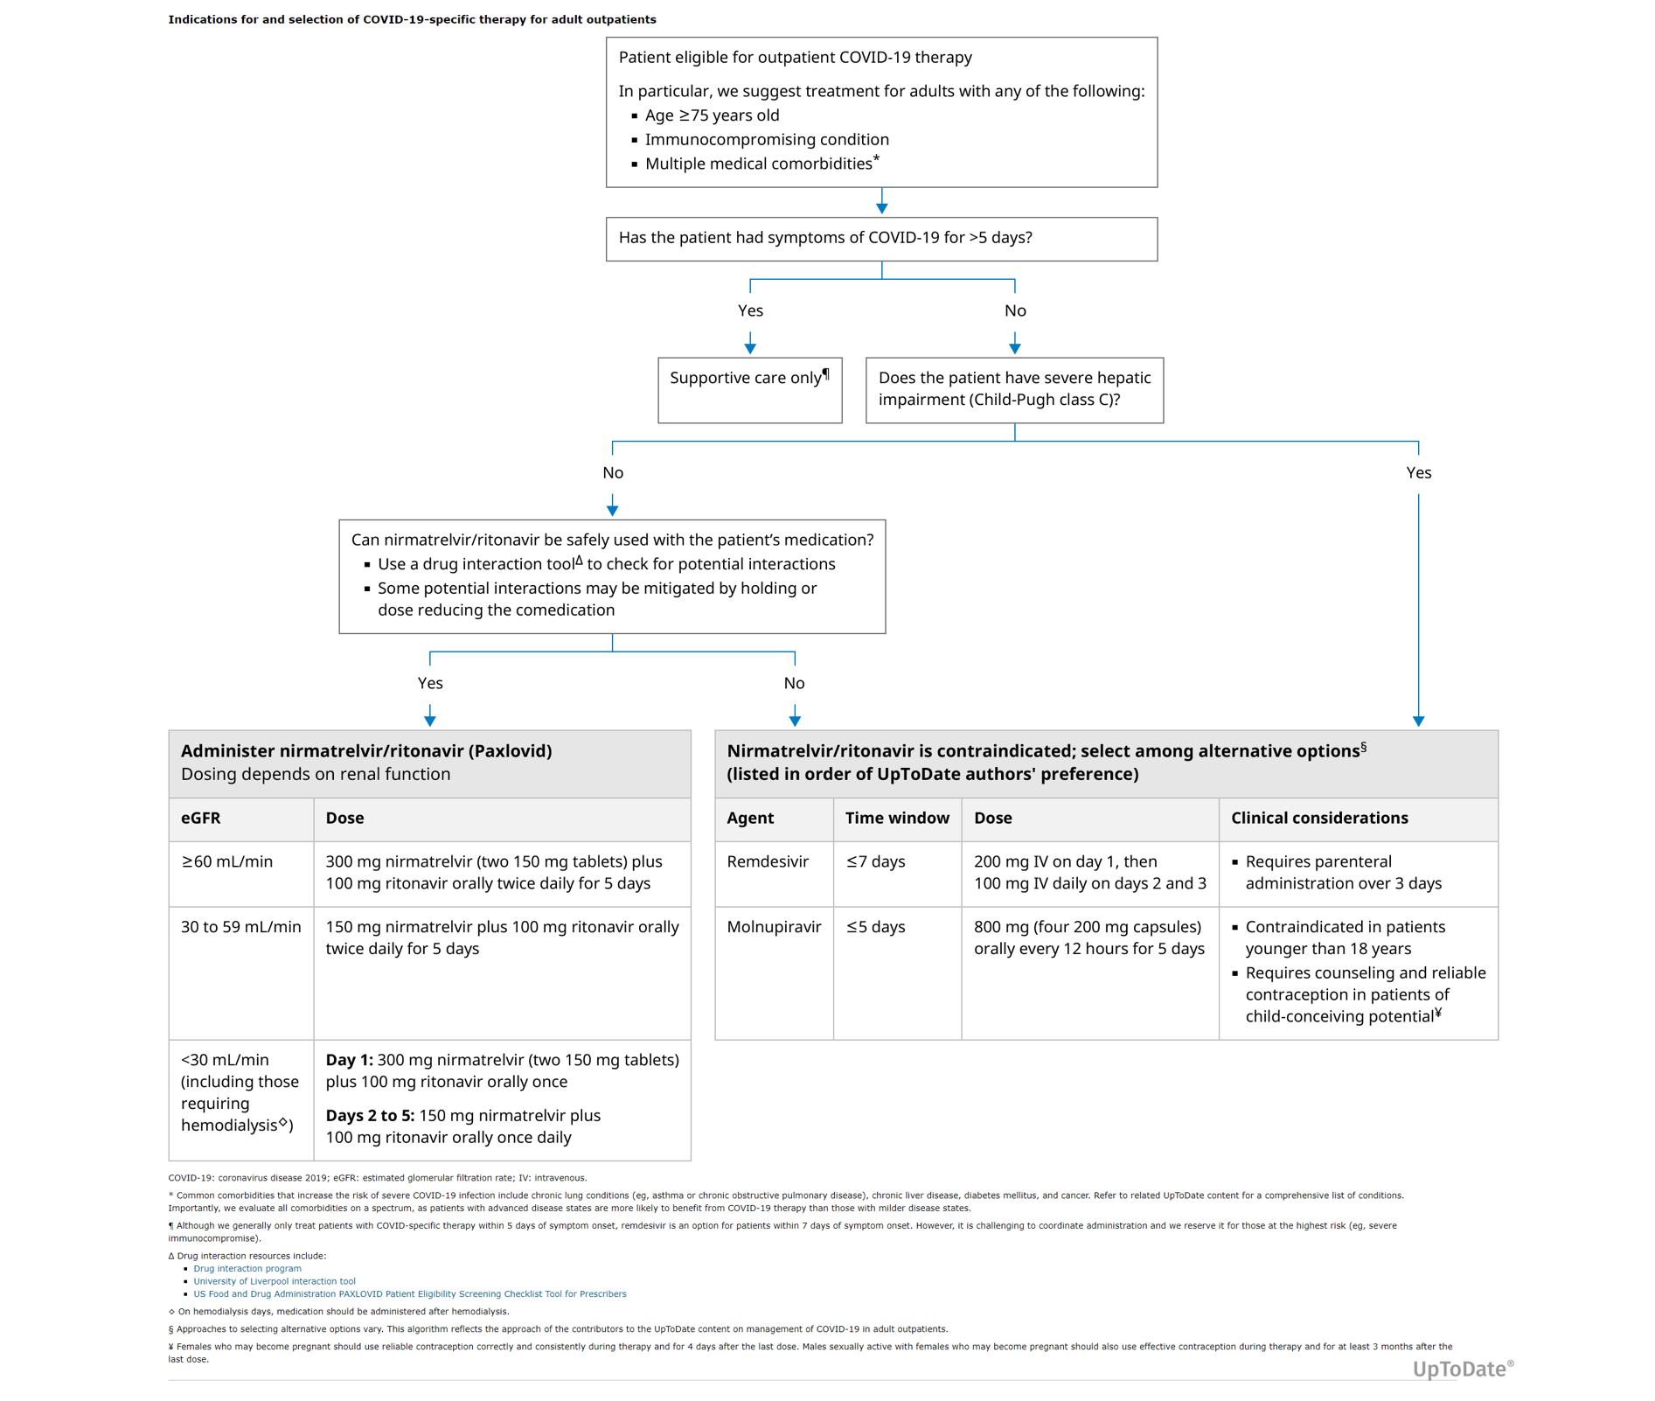

Slide 29
Cont…
Nirmatrelvir-ritonavir as preferred therapy – a combination of protease inhibitors.
Nirmatrelvir blocks the activity of viral 3CL protease while ritonavir slows it’s metabolism so nirmatrelvir remains active in the body for longer.
The EPIC-HR trial shows pts had a reduced risk of hospitalization or death by 89% as compared to placebo.
Hammond J, Leister-Tebbe H, Gardner A, Abreu P, Bao W, Wisemandle W, Baniecki M, Hendrick VM, Damle B, Simón-Campos A, Pypstra R, Rusnak JM; EPIC-HR Investigators. Oral Nirmatrelvir for High-Risk, Nonhospitalized Adults with Covid-19. N Engl J Med. 2022 Apr 14;386(15):1397-1408. doi: 10.1056/NEJMoa2118542. Epub 2022 Feb 16. PMID: 35172054; PMCID: PMC8908851.

Slide 30
Rebound COVID-19 After Rx
Refers to recurrence of symptoms following initial improvement and/or increase in viral levels following initial decline (eg, as reflected by return to antigen positivity after having converted to negative antigen tests) within the first few weeks (usually 10 to 14 days) following infection.
Episodes are usually mild, COVID-19 specific therapy is only given to selected pts with significant immunosuppression.

Slide 31
Not Recommended Therapies
Inhaled glucocorticoids
Systemic glucocorticoids (esp in outpatients)
Hydroxychloroquine and Azithromycin
Antibiotics
Montelukast
Supplementation with vitamin C, vitamin D or zinc
Boulware DR, Lindsell CJ, Stewart TG, Hernandez AF, Collins S, McCarthy MW, Jayaweera D, Gentile N, Castro M, Sulkowski M, McTigue K, Felker GM, Ginde AA, Dunsmore SE, Adam SJ, DeLong A, Hanna G, Remaly A, Thicklin F, Wilder R, Wilson S, Shenkman E, Naggie S; ACTIV-6 Study Group and Investigators. Inhaled Fluticasone Furoate for Outpatient Treatment of Covid-19. N Engl J Med. 2023 Sep 21;389(12):1085-1095. doi: 10.1056/NEJMoa2209421. PMID: 37733308; PMCID: PMC10597427.

Slide 32
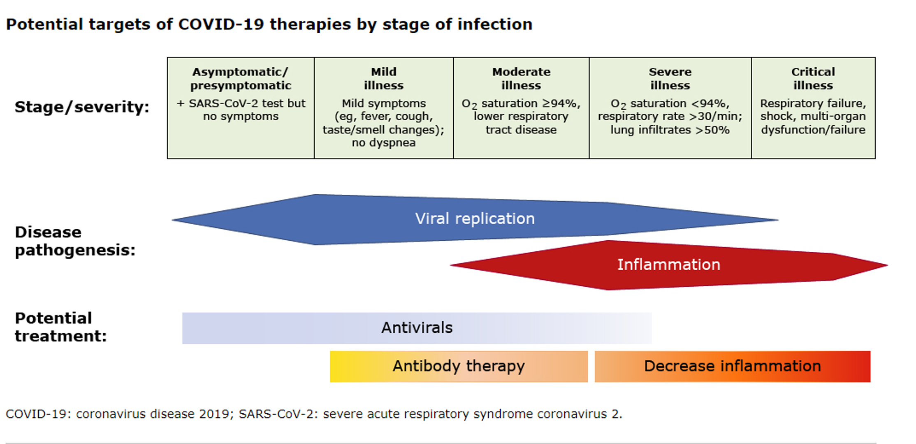
Management in Hospitalized Adults

Slide 33
Cont…
For patients without oxygen requirement:
With risk factors for severe disease (clinical or laboratory), remdesivir is recommended.
For those with no risk factors for severe disease, only supportive care should be given.
For patients with oxygen requirement/severe disease:
Depends on the oxygen/ventilatory requirement
COVID-19 specific therapy is prioritized

Slide 34
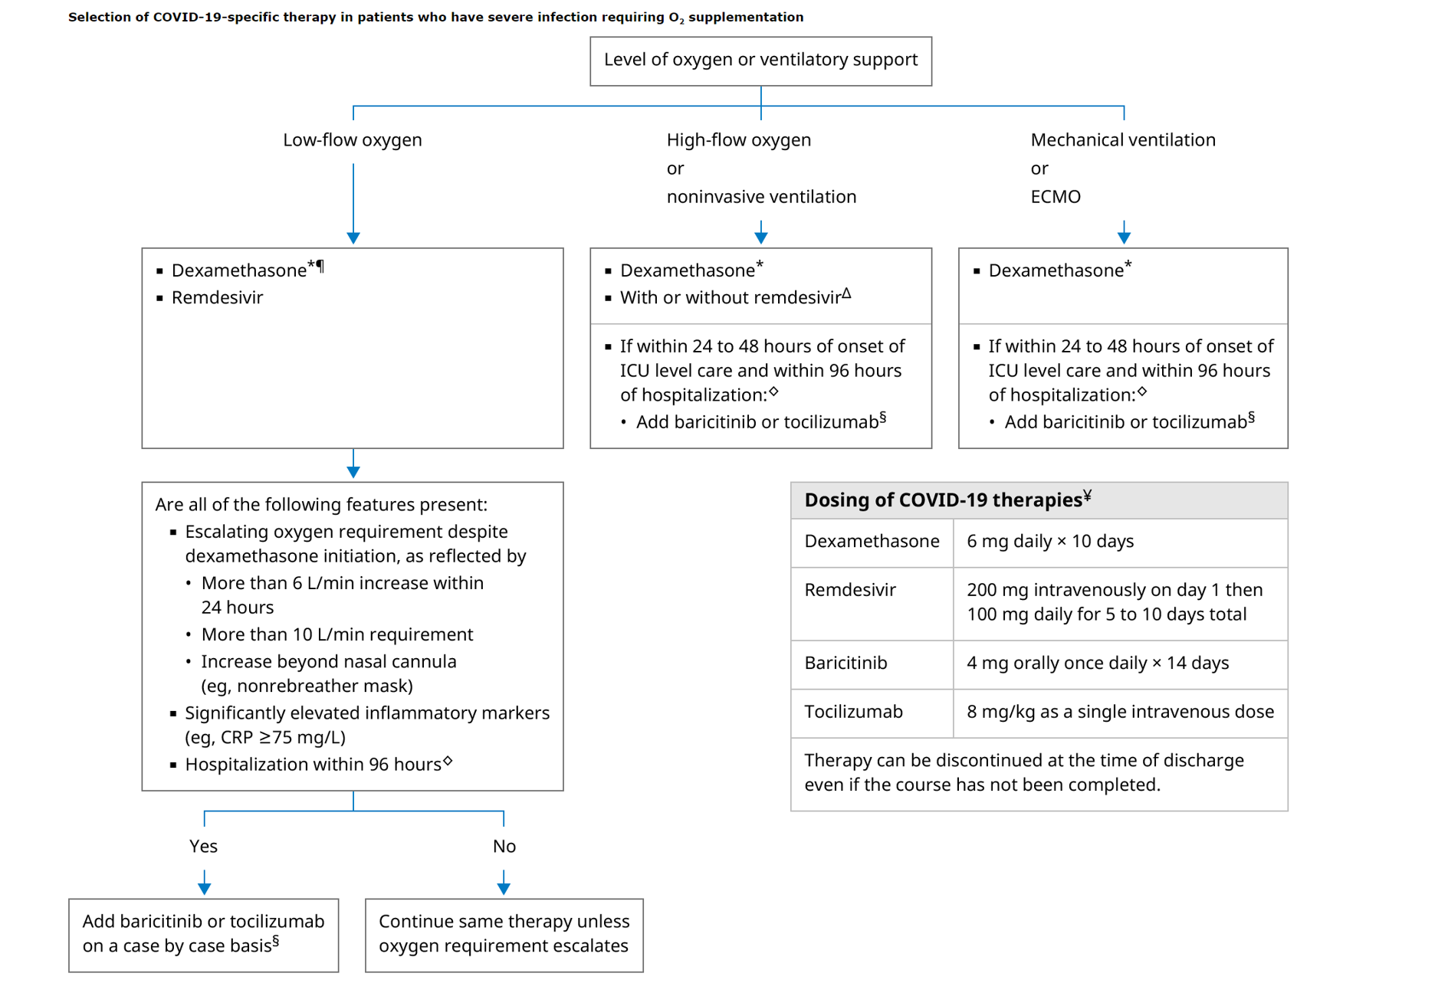

Slide 35
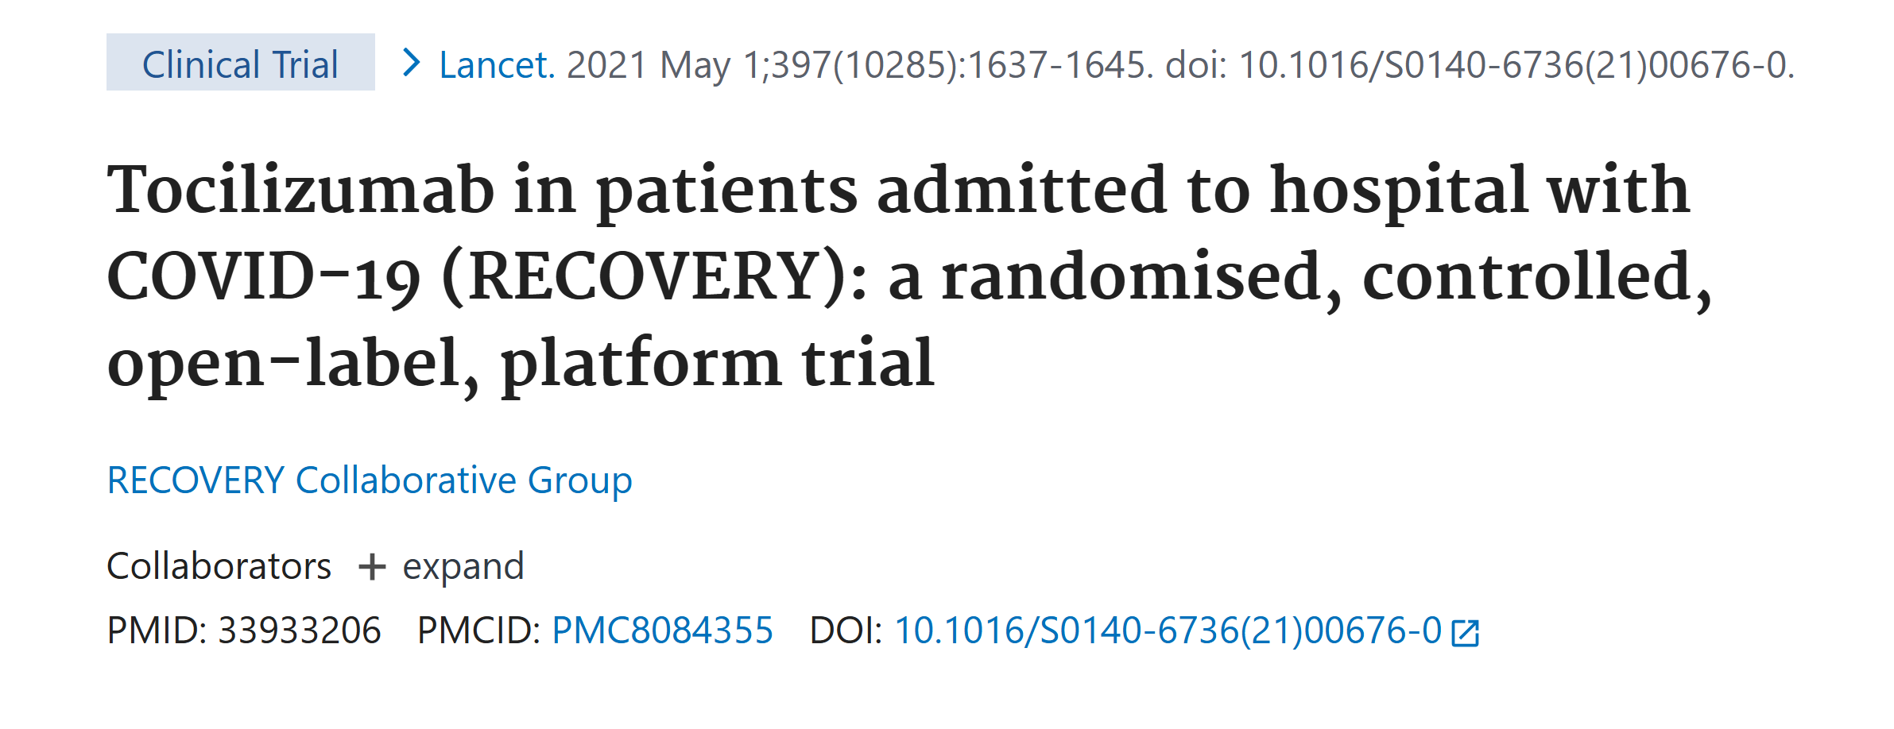

Slide 36
Practice Qn
A 76-year-old man presents at OPD with 3/7 hx of a sore throat, mild dry cough and a low grade fever. He completed his initial COVID-19 primary vaccines series several years ago but has not received any recent boosters. Has T2DM (well controlled).
On examination, T – 38.1 C, HR 82 bpm, SpO2 96% on R/A, RR 18 breaths/min, BP 144/78 mmHg. A rapid Ag test is positive for SARS-CoV-2. Qns:
  What is the proper disposition for the patient?
  What is the preferred first line Rx?
  What safety steps must the clinician observe?

Slide 37
References
Puntmann VO, Carerj ML, Wieters I, et al. Outcomes of Cardiovascular Magnetic Resonance Imaging in Patients Recently Recovered From Coronavirus Disease 2019 (COVID-19). JAMA Cardiol. 2020 Nov 1;5(11):1265-1273.
Chen N, Zhou M, Dong X, et al. Epidemiological and clinical characteristics of 99 cases of 2019 novel coronavirus pneumonia in Wuhan, China: a descriptive study. Lancet. 2020 Feb 15;395(10223):507-513.

Slide 38
Cont…
3) PRINCIPLE Trial Collaborative Group. Azithromycin for community treatment of suspected COVID-19 in people at increased risk of an adverse clinical course in the UK. Lancet. 2021 Mar 20;397(10279):1063-1074.
4) Uptodate.com

Slide 39

This Photo by Unknown Author is licensed under CC BY-SA-NC

